Slide 1
Visualizing Employee Attendance Trends With Excel Charts
STUDENT NAME:ROOBINI.B
REGISTER NO:312217040(asunm1659312217040)
DEPARTMENT: B COM(GENERAL)
COLLEGE: SHRI KRISHNASWAMY COLLEGE FOR WOMEN

Slide 2
PROJECT TITLE Visualizing Employee Attendance Trends With Excel Charts

Slide 3


AGENDA
Problem Statement
Project Overview
End Users
Our Solution and Proposition
Dataset Description
Modelling Approach
Results and Discussion
Conclusion
3/21/2024 Annual Review

Slide 4

PROBLEM STATEMENT
Objective: To utilize Excel charts to effectively visualize and analyze employee attendance trends, enabling better understanding of attendance patterns and supporting data-driven management decisions.Requirements. 1.Data Collection: Obtain comprehensive employee attendance data, including dates, times, and employee identifiers. Ensure the data spans a sufficient period (e.g., a quarter or year) for meaningful analysis. 2.Data Preparation: Clean the data by removing duplicates, correcting errors, and filling in mising values. Structure the data in a format suitable for Excel, such as a table with columns for Date, Employee ID, Attendance Status (e.g., Present, Absent, Late), and Department.

Slide 5

PROJECT OVERVIEW
1. Define ObjectivesIdentify Goals: What do you want to learn from the attendance data? For example, trends in absenteeism, peak attendance periods, or the impact of holidays.Determine Metrics: Metrics could include attendance rates, absenteeism rates, late arrivals, etc. 2. Collect and Prepare DataData Collection: Gather attendance data, which might include employee names, dates, status (present, absent, late), and reasons for absences.Data Preparation: Clean and structure the data. Ensure dates are in a consistent format and that all relevant information is included.3. Choose Appropriate Chart TypesLine Chart: Useful for showing trends over time, like monthly or weekly. 3.Choose Appropriate Chart TypesLine Chart: Useful for showing trends over time, like monthly or weekly attendance rates.Bar Chart: Ideal for comparing attendance across different employees or departments.Pie Chart: Helps visualize the proportion of absences versus present days.Heat Map: Displays attendance patterns by day of the week or month, highlighting peak times for absences.
.

Slide 6

WHO ARE THE END USERS?
1.HR Managers Needs: Track overall attendance trends, identify patterns, and manage absenteeism. Use: Evaluate the effectiveness of attendance policies and identify areas for improvement. 2. Team Leaders and Supervisors Needs: Monitor attendance of their team members and manage day-to-day operations. Use: Address attendance issues, plan for absences, and ensure team coverage. 3. Payroll Department Needs: Ensure accurate tracking of employee attendance for payroll processing. Use: Reconcile attendance data with pay records and manage discrepancies. 4. Employees Needs: Track their own attendance and understand how it affects their performance reviews. Use: Self-monitor attendance to ensure compliance with company policies.

Slide 7

OUR SOLUTION AND ITS VALUE PROPOSITION
Solution Components. 1.Data Collection and Preparation: Gather Attendance Data: Collect data on employee attendance, including dates, status (present/absent/late), and reasons. Data Cleaning: Ensure data is accurate, complete, and formatted consistently. 2.Chart Creation: Line Charts: Display trends over time, showing fluctuations in attendance rates. Bar Charts: Compare attendance metrics across departments or individual employees. Pie Charts: Visualize the proportion of different attendance statuses. Heat Maps: Highlight patterns in attendance by day of the week or month.

Slide 8
Dataset Description
Dataset Components 1.Employee Information: Employee ID: Unique identifier for each employee. Employee Name: Full name of the employee. Department: Department or team the employee belongs to. 2.Attendance Records: Date: The specific date of attendance. Status: Attendance status for the day (e.g., Present, Absent, Late, Excused). Reason (Optional): Reason for absence or lateness (e.g., Sick Leave, Vacation, Personal). Time In/Out (Optional): Actual clock-in and clock-out times, which can be useful for detailed analysis of lateness. 3. Additional Details (Optional): Hours Worked: Total hours worked each day, which can help analyze patterns in productivity and attendance. Shift: Shift details (e.g., Morning, Evening) if applicable, to understand attendance trends across different shifts. Holiday Indicator: Indicator if the day is a holiday, which helps in understanding attendance in relation to non-working days.

Slide 9

THE "WOW" IN OUR SOLUTION
1. Interactive Dashboards: Dynamic Filtering: Allow users to filter data by employee, department, date range, or attendance status directly in the dashboard. Drill-Down Capability: Enable users to click on summary charts to view more detailed data, such as individual employee attendance records. 2. Customizable Visualizations: Tailored Charts: Create bespoke charts and graphs that cater specifically to the needs of different stakeholders (e.g., HR managers, team leaders). Real-Time Updates: Incorporate live data updates to ensure that charts reflect the most current information. 3. Advanced Analysis Tools: Trend Analysis: Use advanced chart types like line charts with trendlines or sparklines to show long-term attendance patterns. Comparative Views: Implement side-by-side comparisons to analyze attendance trends across different periods or departments. 4. Data Integration: Comprehensive Data Sets: Integrate multiple data sources (e.g., attendance records, employee performance) to provide a holistic view..
3/21/2024 Annual Review

Slide 10
MODELLING
1.Prepare Your Data: Organize your data in a table format. For example: Date: Date of attendance Employee ID/Name: Employee identifier Attendance Status: Present, Absent, or Leave 2.Create a Pivot Table: Select your data and go to Insert > PivotTable. In the PivotTable Field List, drag Date to the Rows area, and Attendance Status to the Columns area. Drag Employee ID/Name to the Values area, and set it to count occurrences. 3.Insert a Chart: With the PivotTable selected, go to Insert > Charts and choose a suitable chart type (e.g., Line Chart or Bar Chart). Customize the chart by adding titles, labels, and adjusting the axes to make it more readable. 4.Analyze Trends:Use the chart to observe trends over time, such as peak absenteeism periods or overall attendance patterns. 5.Additional Enhancements:Add slicers to filter by different employees or date ranges.Use conditional formatting to highlight specific trends or issues.

Slide 11
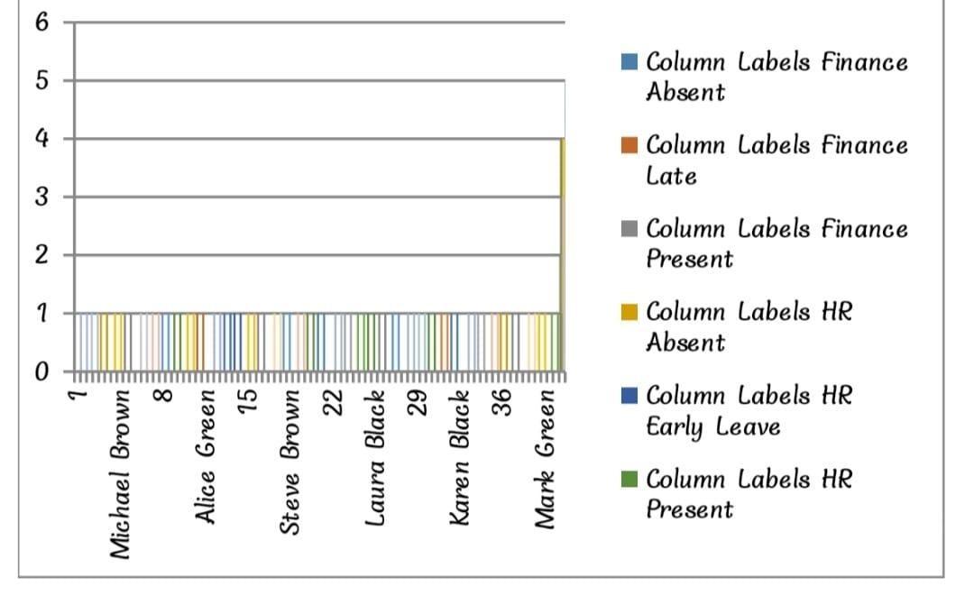
RESULTS

Slide 12
conclusion
In conclusion, visualizing employee attendance trends with Excel charts offers several benefits Clear Insights Charts provide a clear and intuitive way to observe trends over time, making it easier to spot patterns such as peaks, troughs, and anomalies in attendance.

